Slide 1

Wine Classification
using Machine
Learning
Muchoki Jacob
8th July 2025
MAINAJACOB324@GMAIL.COM

Slide 2

INTRODUCTION
Background of the Study
Wines from the same region can exhibit subtle differences in chemical composition due to variations in cultivation methods and environmental conditions. These differences impact taste, aroma, and quality—making accurate classification essential for quality control.
Relevance of the Study
The winery aims to streamline its quality assurance processes by using machine learning to classify wines automatically. Understanding which chemical attributes contribute most to classification can also reduce testing costs by eliminating less relevant tests.
Objective of the Study
To apply machine learning techniques to classify wine cultivars using chemical test data. The study also aims to identify the most significant features influencing classification and evaluate whether fewer tests can still ensure accurate results.

Slide 3

Problem Statement
Business Need
The institute wants to automate wine classification into three cultivars using chemical data.
Manual lab testing is costly and resource-intensive.
What Are We Predicting
We aim to predict the wine cultivar (Class 0, 1, or 2) based on 13 chemical features.
Optimization Goal
Determine if we can achieve high accuracy using fewer features to help reduce lab testing costs.

Slide 4
Data Description
Feature Name | Description
fixed_acidity | Tartaric acid level
volatile_acidity | Acetic acid content
citric_acid | Citric acid level
residual_sugar | Sugar after fermentation
chlorides | Salt content
free_sulfur_dioxide | Antioxidant level
total_sulfur_dioxide | Preservative content
density | Relative density of the wine
pH | Acidity level
sulphates | Sulfate level (stabilizer)
alcohol | Alcohol percentage
quality | Target variable (quality score)
Data Source
Source of the Data
The dataset was obtained from the sklearn.datasets module using the built-in load_wine() function
Dataset Summary
Number of Records: 1,599 (red wine) or 4,898 (white wine)
Data Types: All features are numerical
Missing Values: None detected – the dataset is clean

Slide 5
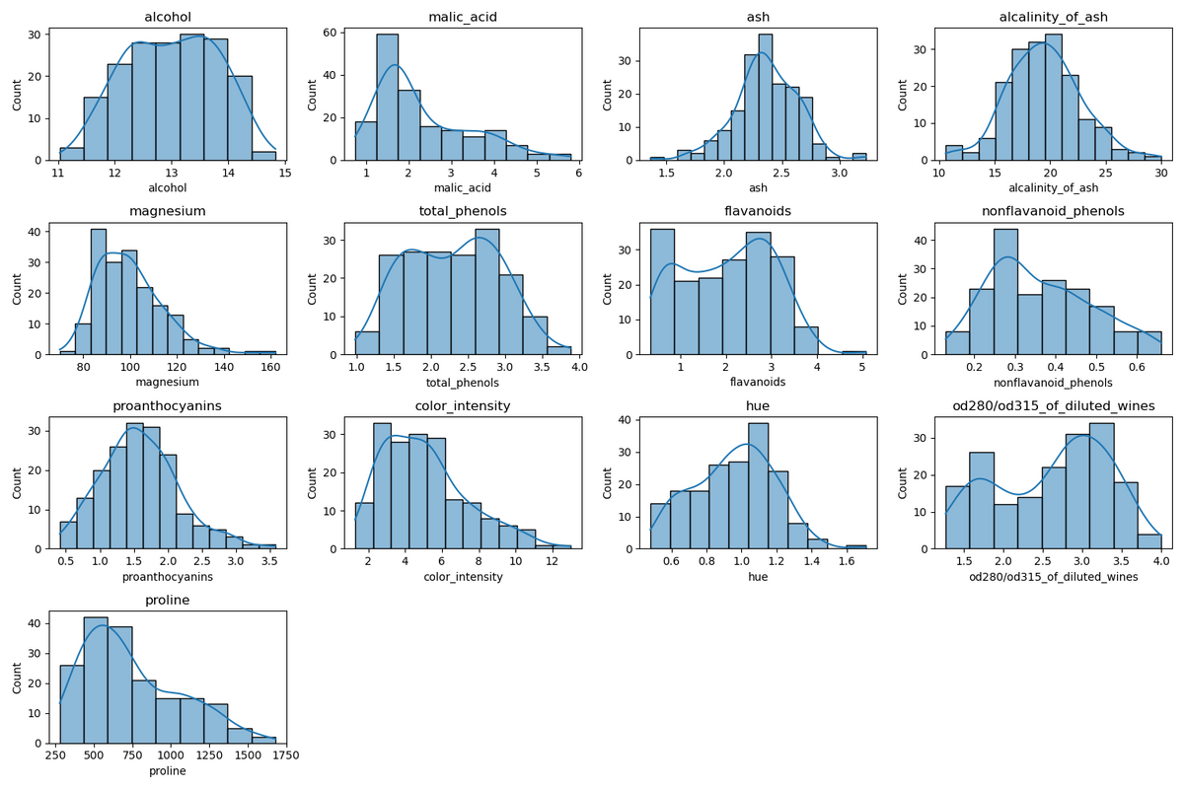
Normal Distribution Features
Feature | Distribution Shape | Insight
alcohol | Symmetrical, slightly skewed | Normal-like distribution
malic_acid | Right-skewed | Most wines have low malic acid
ash | Nearly normal | Centered around 2.5
alcalinity_of_ash | Symmetric | Slight peak near 20
magnesium | Right-skewed | Most values are between 70–100
total_phenols | Fairly uniform | Spread evenly from 1–3
flavonoids | Right-skewed | Many wines with low values
nonflavanoid_phenols | Right-skewed | Similar pattern to flavonoids
proanthocyanins | Normal-like | Balanced spread
color_intensity | Right-skewed | Few very intense-colored wines
hue | Bell-shaped | Typical range 0.8–1.2
od280/od315_of_diluted_wines | Bimodal | Two common groups of wines
proline | Strongly right-skewed | Few wines have very high proline
Summary of Findings
Most features are right-skewed – such as malic_acid, magnesium, proline, and color_intensity. This suggests a concentration of lower values with fewer high-value outliers.
Some features are roughly normally distributed, like ash, alcohol, and hue, making them well-suited for models assuming normality.
A few features show bimodal patterns, especially flavanoids and od280/od315_of_diluted_wines. This could indicate strong class-separating potential.
Proline has a wide range with a strong right skew, indicating it could be a powerful differentiator among wine types.
Feature transformation (e.g., log scaling) might be helpful for skewed features to improve model performance.

Slide 6
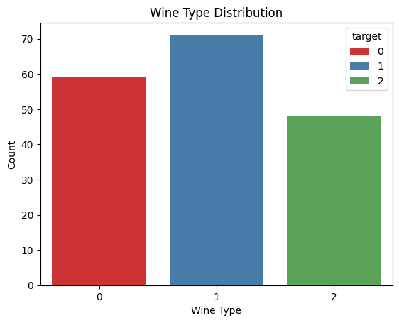
Wine Type
Distribution Analysis
Wine Type Distribution – Analysis
The dataset contains three wine types, labeled as 0, 1, and 2.
Wine Type 1 is the most represented, with approximately 71 entries.
Wine Type 0 follows with about 59 entries.
Wine Type 2 has the lowest representation, with around 48 entries.
Observations:
The data is relatively balanced, though Wine Type 1 has a noticeable lead.
The class imbalance is not extreme, but it's something to be aware of when training classification models, as it could slightly influence performance metrics.

Slide 7
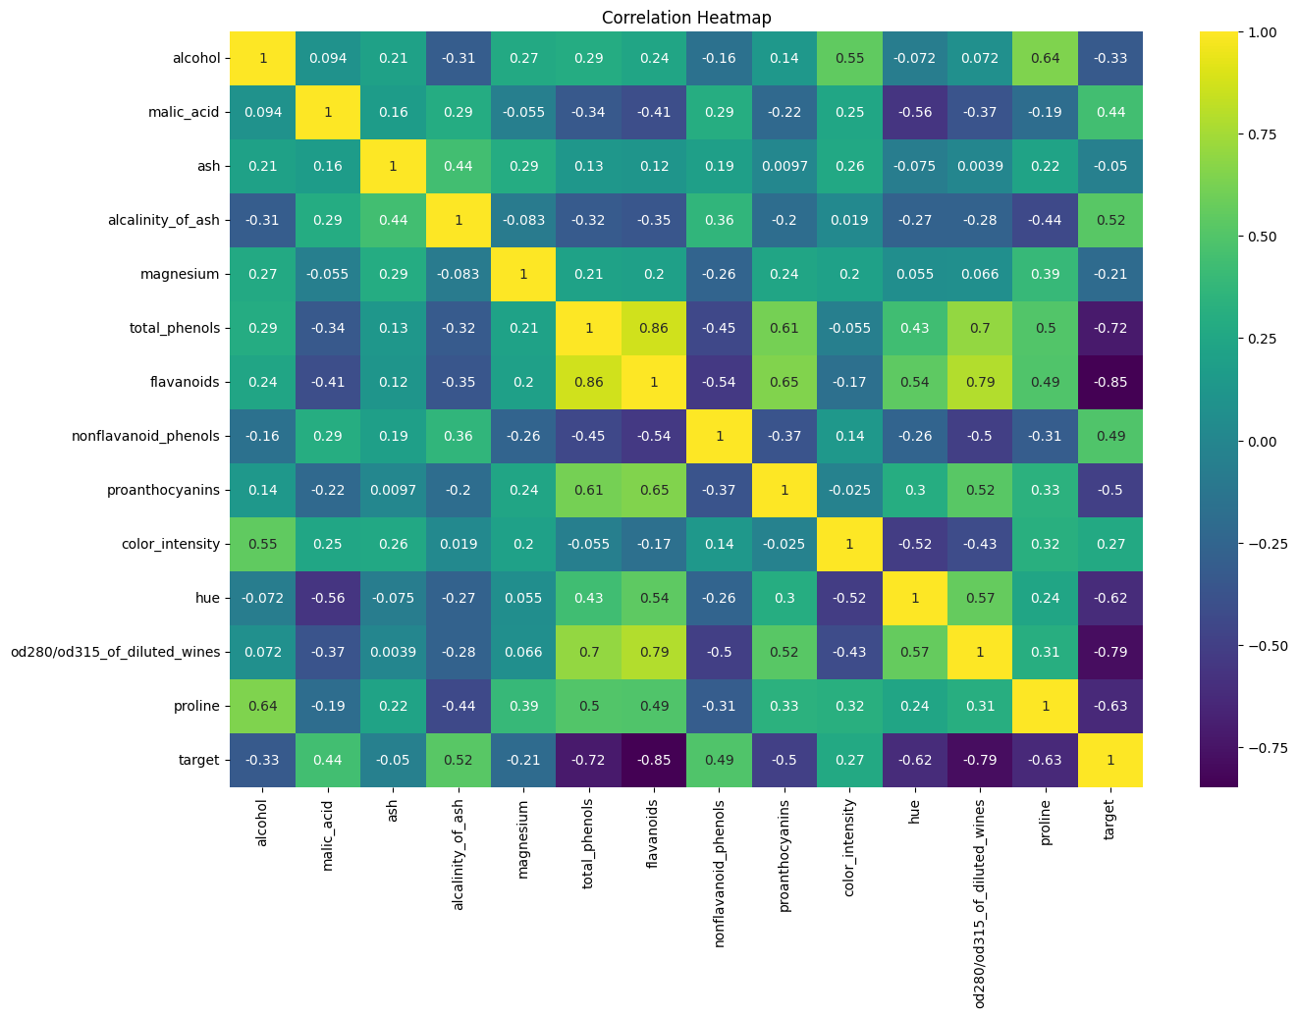
Key Insights from Feature Correlations
The heatmap reveals that flavanoids, total phenols, and OD280/OD315 are highly correlated, suggesting they may represent similar underlying wine characteristics—likely related to antioxidant or polyphenol content. This can help in reducing dimensionality or selecting the most informative feature during model building.
Additionally, the strong negative correlation between malic acid and hue highlights a possible link between wine acidity and color tint, which could reflect quality or type.
Understanding these relationships aids in:
Improving model accuracy by avoiding redundant features,
Interpreting chemical composition linked to wine quality,
And enhancing feature selection for classification or prediction tasks.

Slide 8
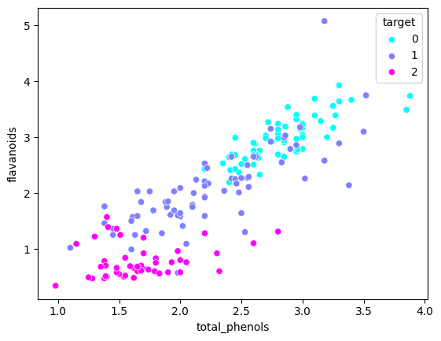
Flavanoids vs. Total Phenols Relationship
From the previous correlation heatmap, we observed a strong positive correlation (0.86) between flavanoids and total_phenols. This scatter plot confirms that relationship visually — as the total_phenols content increases, the flavanoids also tend to increase.
Key Insight:
The points form a clear upward trend, indicating a strong linear relationship.
This suggests that wines with higher total phenolic content generally contain more flavanoids, reinforcing the idea that flavanoids are a major component of total phenols.

Slide 9
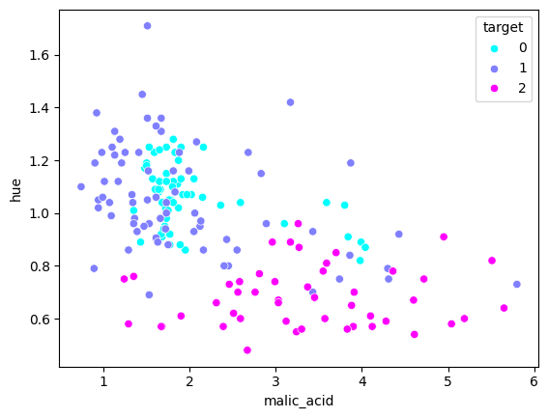
Malic Acid vs. Hue Relationship
From the previous correlation heatmap, we identified that malic_acid and hue had the strongest negative correlation (–0.56) among all feature pairs.
While this scatter plot does not show a clear linear downward trend, we can still observe a slight negative pattern, suggesting that as malic acid increases, the hue tends to decrease.
Key Insight:
The slight downward spread reflects that features like acidity (malic acid) may influence visual properties of wine such as color tint (hue).
This relationship, though not perfectly linear, supports the idea that wine composition affects appearance, and can be considered in modeling or quality analysis.
It highlights subtle but meaningful chemical relationships useful for classification or prediction tasks.

Slide 10
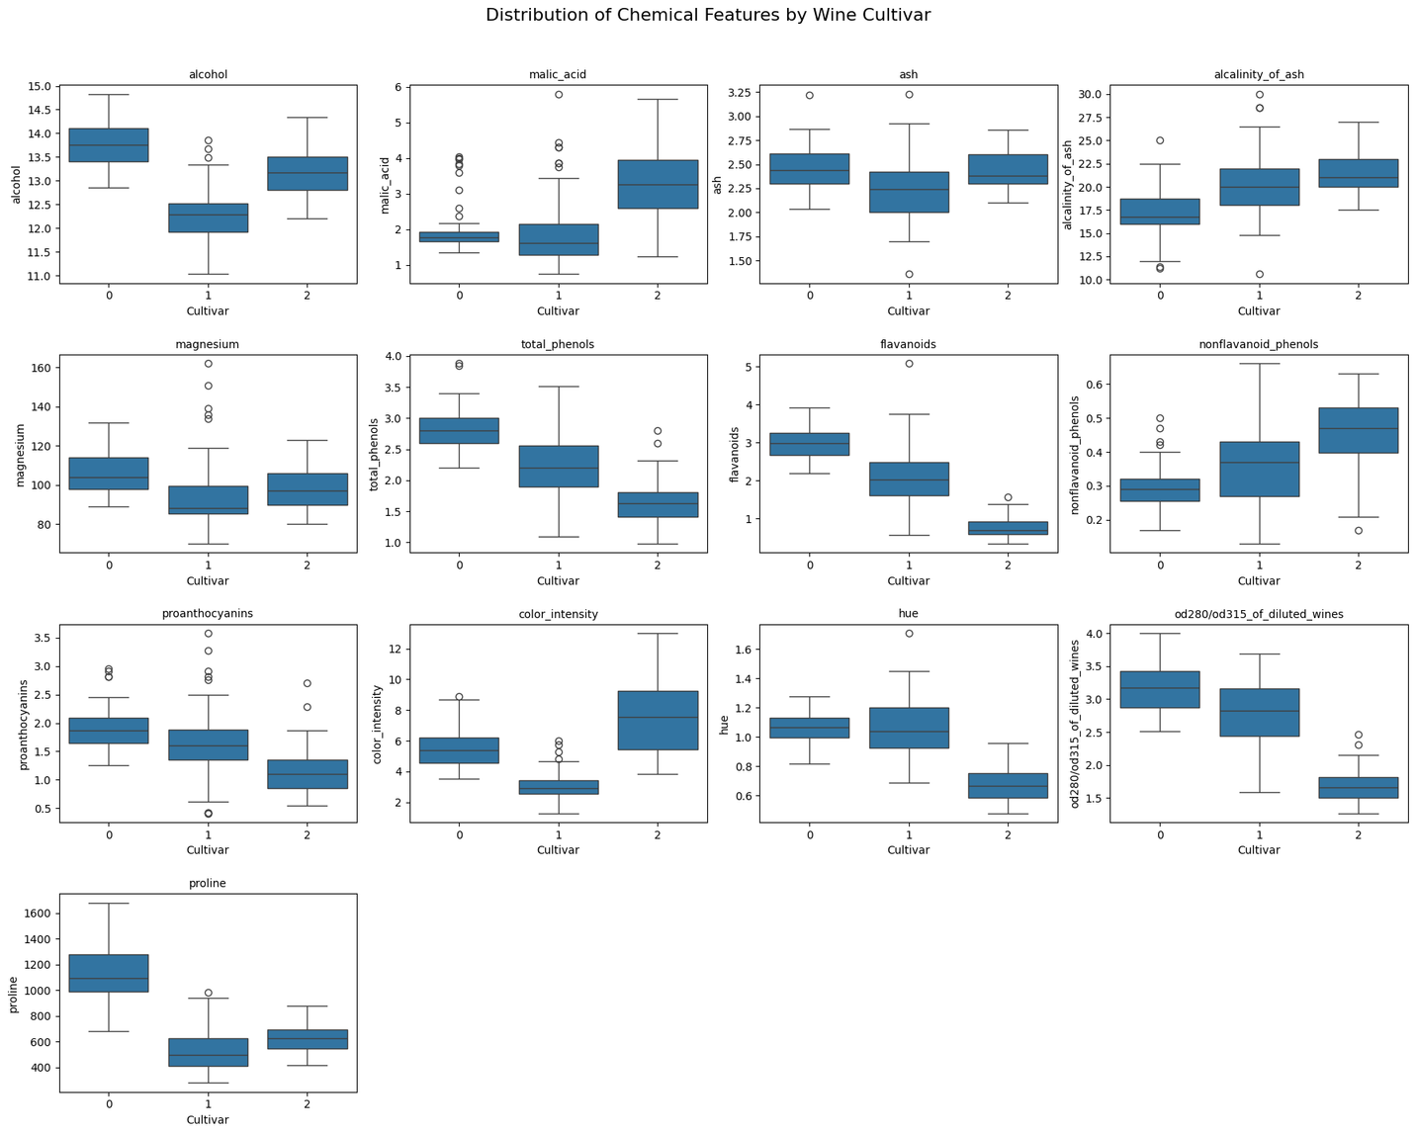
Distribution of Chemical Features by Wine Cultivar
Several ingredients clearly help differentiate the three wine cultivars:
Proline is the strongest indicator for Cultivar 0, with much higher values than the others.
Color Intensity stands out for Cultivar 2, showing the highest median and range.
Alcohol helps distinguish Cultivar 1, which has the lowest average.
OD280/OD315 and Hue are useful in identifying Cultivar 2, both showing distinct value patterns.
Flavanoids and Total Phenols effectively separate Cultivar 0 from Cultivar 2.
Less useful features include Ash, Magnesium, and Alcalinity of Ash, which show high overlap.

Slide 11
Exploratory Data Analysis (EDA)
Trends Trends :
Wine Class 0 has the most samples, while Class 2 has the fewest.
Class 0 wines tend to have higher values in features like Proline, Flavanoids, and Total Phenols.
Class 1 shows the lowest Alcohol content, clearly separating it from the other two.
Class 2 stands out with higher Color Intensity and a wider range of Malic Acid values.
Outliers:
No significant outliers were detected; most values across features appeared to be within a close range.
The dataset is fairly clean, with no extreme anomalies affecting the analysis or model performance.
Correlations:
Most features showed low to moderate correlation, indicating they contribute independent information.
Flavanoids and Total Phenols showed the strongest positive correlation (+0.86), suggesting wines with more phenols tend to have higher flavonoids.
This strong correlation may indicate a shared chemical characteristic common in certain wine classes, especially Class 0.

Slide 12
Methodology
Models used:
Training Strategy and Evaluation Method
K-NEAREST NEIGHBORS
1
Used a 70/30 train-test split to train the model on 70% of the data and test on 30%.
Applied 5-fold cross-validation to improve model reliability and reduce overfitting.
Enabled OOB (Out-of-Bag) scoring in the Random Forest model for internal validation using unsampled data.
LOGISTIC REGRESSION
2
ANALYZE DATA
3
Feature Engineering and Selection
DECISION TREE
Recursive Feature Elimination (RFE) was used to identify the most relevant features, improving model focus and reducing noise.
Principal Component Analysis (PCA) was applied to reduce dimensionality while retaining most of the data variance.
No additional feature transformations or new feature creations were necessary, as the dataset was already clean and well-structured.
4
RANDOM FOREST
5
SUPPORT VECTOR MACHINE
6

Slide 13
Modeling & Evaluation
Model Performance Insights:
K-Nearest Neighbors (KNN) performed the best with an accuracy of 98.1%, indicating strong predictive power for this dataset.
Decision Tree, Logistic Regression, and Support Vector Machine (SVM) all achieved solid and equal performance with an accuracy of 96.3%.
Random Forest had the lowest score at 92.6%, though still a strong result, suggesting slight overfitting or sensitivity to the data split.
Conclusion
Overall, all models showed high accuracy, confirming that the features in the dataset are informative and well-suited for classification.

Slide 14
Results & Insights
Key Findings from the Model
All models achieved high accuracy (above 92%), with KNN performing best at 98.1%, showing that the dataset is highly classifiable.
Top contributing features identified were Proline, Flavanoids, Color Intensity, and OD280/OD315, which significantly influenced classification.
Patterns or Relationships Discovered
Wines from Cultivar 0 generally have higher Proline and Flavanoids, making them easier to distinguish.
Cultivar 2 stands out with higher Color Intensity and lower OD280/OD315, helping separate it from the others.
Strong positive correlation found between Total Phenols and Flavanoids (r = 0.86), indicating a shared chemical trait.
Business or Domain Interpretation
Chemical composition can be used reliably to automate wine classification, supporting quality control and vineyard management.
Wine producers can focus on key chemical markers like Proline and Color Intensity to monitor and distinguish wine types.
These insights can help in marketing strategies, ensuring wines are categorized and labeled accurately based on their chemical profiles.

Slide 15
Recommendations
Focus on key features only: Based on feature selection (RFE & PCA), properties like Proline, Flavanoids, Color Intensity, and OD280/OD315 are the most effective in differentiating wine cultivars. Limiting lab tests to these can significantly reduce costs without major loss in accuracy.
Use a simplified model for efficiency: Even with fewer features, models like K-Nearest Neighbors (KNN) maintained high accuracy (98.1%), making it ideal for cost-effective, accurate classification
Adopt KNN for automation:
Recommend KNN as the best-performing model for automating wine classification due to:
Its simplicity and high performance
No need for intensive training time
Performs well even with a reduced feature set
Next steps: Implement the KNN model in the production pipeline using selected features to achieve accurate, low-cost, and automated classification.
MAINAJACOB324@GMAIL.COM

Slide 16

Conclusion:
Accurate wine classification is achievable using fewer key chemical features, with KNN proving to be an effective and efficient model for automation and cost reduction.

Slide 17
Thankyou
Smart solutions for a refined future
Muchoki Maina
MAINAJACOB324@GMAIL.COM

